Slide 1
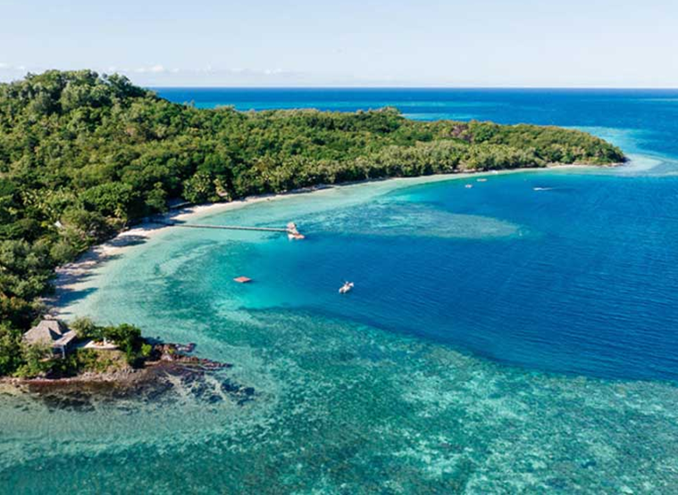
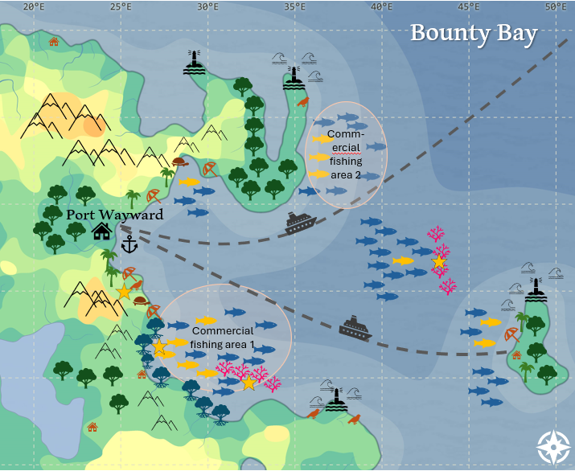
Marine Spatial Planning (MSP)
Role Play
Unit

Slide 2
Learning Outcomes
Demonstrate a critical understanding of the key principles, frameworks, and tools underpinning marine spatial planning (MSP), including the ecosystem approach and social-ecological systems thinking.
Analyse and interpret the interactions, trade-offs, and synergies between ecological, social, cultural, and economic objectives in a multi-use marine environment.
Apply MSP concepts and processes to design spatial management strategies that address real-world policy objectives and sectoral challenges.
Negotiate and communicate effectively in a multi-stakeholder context, showing the ability to represent stakeholder interests, identify areas of compromise, and build consensus on shared marine plans.
Demonstrate professional skills in collaboration, strategic thinking, and adaptive decision-making in response to evolving stakeholder dynamics and policy constraints.
Critically reflect on the governance, ethical, and power dimensions of marine planning, evaluating how transparency, hidden interests, and participation influence policy outcomes.

Slide 3
Materials
This unit guide contains the set-up of the role playing game, the role cards for the stakeholders, the base map and legend, the game rules and instructions for students, order of events as well as mid-game twist scenarios, prompts for debrief questions and a marking scheme based on the learning criteria.
You will need one preparation session (assuming students have learned about MSP concepts) where you will explain the role play to the students and distribute roles (you could also do that ad-hoc). At this point, do not share the exact map with them. You can take them through part of this presentation to show them the rules and give a brief glimpse at the map, but do not let them keep the map yet.
Students should then have time to prepare their roles and strategies before the role play starts.
On the day of the role playing game session (ca. 90 min), you will share the map with them and the negotiations will begin (see slide 10 Game Play).
You will need
This presentation to guide you through – and to put some slides on a screen
Printed: several copies of the map for stakeholders to draw on, role cards, mid-game scenarios, marking schemes to mark students
Pens, pencils, markers, timer

Slide 4
Assignment description for students before the preparation session (module handbook)
The MSP Challenge is a strategy exercise role play around a fictitious sea basin, where different maritime sectors and uses (e.g. aquaculture, tourism, etc.) coexist. Participants adopt roles as representatives of key local interests and sectors, negotiate with each other and agree in which areas these activities can be developed to fulfil their policy objectives. Students are given a stakeholder role which they will research and prepare before the assessment session. On the day of the exercise, a scenario is then played where stakeholders have to negotiate in order to reach a consensus marine spatial plan.
You will be given a role as a marine or coastal stakeholder in a hypothetical marine spatial planning process
Research your role, their group, their needs, positionality and likely response to other marine users/their propositions - make a list of what is important to you and why
You can develop your character as you like – be creative
Think about what your ‘opponents’ might want and say, or what they will fight you for – and how you might deal with that – add to your notes
Think of what others’ needs and wants in the coastal and marine space are, and come up with ideas and solutions that might satisfy multiple needs – come up with a list of suggestions
Submit: List or text on your role, your preparation
Play your part in the role play, stating your interests and negotiating for the best possible MSP outcome
Reflect on how it went, both in your role and as a group.

Slide 5
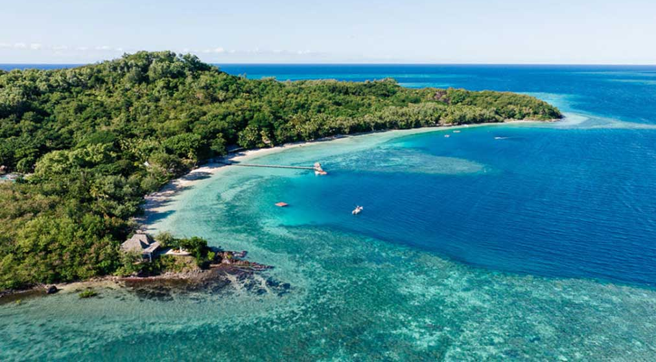
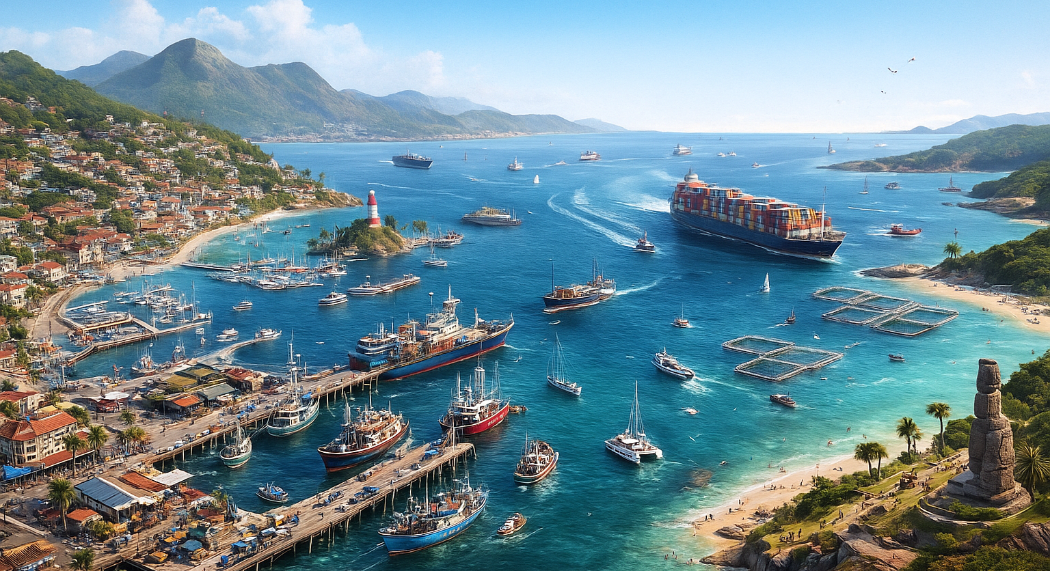
Welcome to Bounty Bay
It´s a busy bay with a port town, shipping lanes, established fishing sector, and other activities and interests like tourism, aquaculture, conservation and traditional use and cultural sites.
Players must assume their stakeholder roles and negotiate according to their interests, attempting to find a compromise on how to organize and manage the areas in Bounty Bay.
Everyone also has at least one secret goal that they are trying to achieve whilst not sharing this with others.

Slide 6
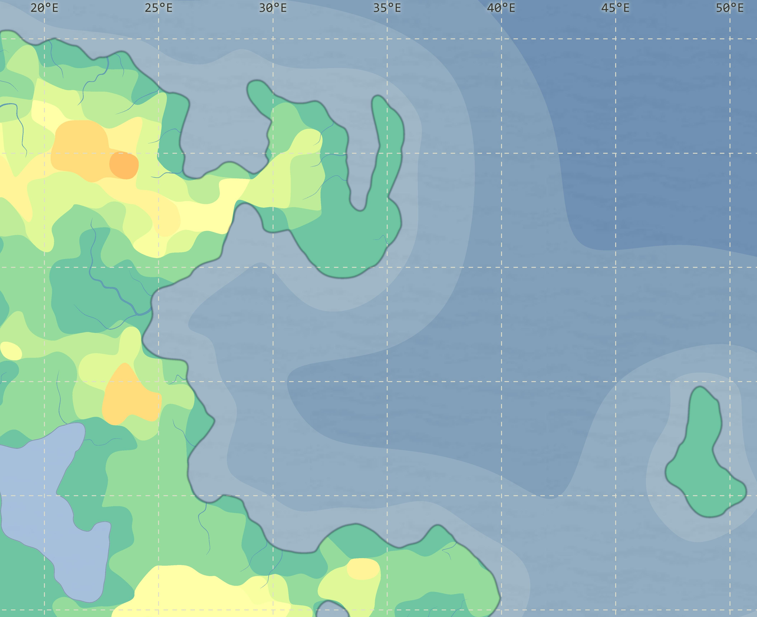














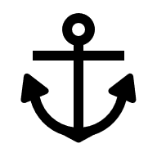



Bounty Bay
Port Wayward
Notes:
To be printed in large format and several times for stakeholders to draw and mark on. Length of one square equals 2km.

Slide 7
Bounty Bay
Comm-ercial fishing area 2
Port Wayward
Commercial fishing area 1
Notes:
Shows current pre-game established fishing grounds

Slide 8
Legend
Main town
Village
Harbour
Lighthouse
Palms
Dense tropical forest
Mangroves
Southern petrel (protected species) nesting site
Emerald turtle (protected species) breeding beach
Rich fish habitat
Goldling fish (red listed species) habitat
Recreation area, pristine beach
Site of traditional cultural importance and use
Dangerous currents/waves
Fixed shipping lanes
Mountains
Reef habitat
Planning jurisdiction limit

Slide 9
Non-negotiable facts
Existing shipping lanes can´t be moved, and a buffer space needs to be held clear. Ships impact nearby zones.
Port Wayward is the established town and population centre. Its port is crucial for most seagoing activities and supplies.
Mangrove habitats have fragile partial protection status due to their storm defense abilities and as nursery grounds for juvenile fish. Need decisions on extent and co-management.

Slide 10

Questions to negotiate
Where should aquaculture go (if at all)?
Should there be a formal conservation/protected zone? Where?
How will fishing grounds be safeguarded, shared, or moved?
What rights or zones should the Indigenous/traditional community group have?
How to ensure tourism access and clean waters?
What does the final zoning map look like (5–6 distinct zones)? You can establish exclusive rights zones, shared zones, multiple use zones and create rules and limits for uses and users.

Slide 11
Game Play (ca. 90 min)
Stage | Time | Activity
Preparation | Before the meeting | Stakeholders prepare their roles, ideal outcomes, likely opposing stakeholders´ strategies and responses.
Briefing | 5-10 min | Planner explains MSP, rules of game, process and non-negotiables around Bounty Bay.
Initial Proposals | 15 min | Stakeholders each mark or state their primary interest zones on map and the conditions they prefer. Planner moderates.
Optional “Secret Trade Round” | 10 min | Stakeholders have the option to meet others privately, to discuss common interests and form alliances. Planner observes.
Negotiation & Trade-Offs | 20 min | Stakeholders discuss conflicts, suggest compromises and trade-offs, i.e. shared zones. Planner helps with compromises.
Optional Scenario Twist | 5 min | Planner may introduce a twist scenario that changes the outcome.
Consensus Attempt | 15 min | Group agrees or partially agrees on a final plan with zones and rules.
Debrief | 15 min | Reflection on negotiation, trade-offs and lessons learned.

Slide 12

Role cards
6 students

Slide 13
Local Authority
&
Marine Planner
Public role and interests
Runs the meeting and ensures balanced input.
Must keep the plan realistic and politically defensible.
Balances ecological, cultural, and economic needs.
Can introduce a scenario twist mid-game.
Mediates between conflicting interests; neutral but under pressure to deliver consensus.
When facts are debated, the planner is the judge – you can make up facts, scenarios and limitations (how much things would cost, how endangered a species is, how feasible ideas would be, etc.)
Secret goal – Do not share this but negotiate with this in mind!
Ensure the plan produces visible economic activity for investment (for re-election & funding).
Avoid public backlash — no single stakeholder should “lose out completely.”

Slide 14
Aquaculture Company
Public role and interests
Seeks to establish nearshore aquaculture sites sustainably, ideally sheltered zone near port
Not near polluted rivers, needs good water and social acceptance.
Prioritises profitability and growth, but open to compromise if operations can expand.
Secret goal – Do not share this but negotiate with this in mind!
Secure exclusive use rights for at least one prime nearshore site (not a shared-use zone).
Keep environmental regulations minimal or voluntary.

Slide 15
Commercial Fisheries Association
Public role and interests
Represents fishers who need continued access to key productive grounds.
Opposes spatial restrictions that reduce income or access.
Opposes permanent closures but can accept seasonal limits.
May support conservation if fish stocks improve.
Secret goal – Do not share this but negotiate with this in mind!
Prevent any new “no-take” zones in their most productive area.
Get government compensation or infrastructure (i.e. fuel subsidy) if restrictions happen.

Slide 16
Tourism Association
Public role and interests
Seeks clean, and visually attractive coastlines and safe waters for visitors and recreation.
Opposes visual/industrial impacts near beaches.
Could promote eco- and cultural tourism partnerships.
Secret goal – Do not share this but negotiate with this in mind!
Block any aquaculture visible from main beaches.
Secure an exclusive “eco-tourism” concession in part of the cultural or reef zone.

Slide 17
Indigenous/ Traditional Community Leader
Public role and interests
Advocates for cultural and spiritual connections to the coast; values traditional fishing, mangroves, and sacred sites.
Protects traditional fishing grounds, sacred mangroves, and reef areas.
Supports co-management and cultural zones.
May accept development if respectful and beneficial to community.
Secret goal – Do not share this but negotiate with this in mind!
Gain formal recognition or written commitment to co-manage a specific area.
Stop any project (aquaculture, tourism, commercial fishing) near sacred mangroves.

Slide 18
Environmental NGO
Public role and interests
Advocates for biodiversity protection and ecosystem-based MSP.
Supports zoning that safeguards habitats, reefs, mangroves, and traditional fisheries.
Prefers “no-take” zones or low-impact use areas; open to compromise if strong safeguards exist.
Secret goal – Do not share this but negotiate with this in mind!
Achieve at least one legally binding no-take/no-activity conservation zone.
Push the planner to include legal environmental limits in aquaculture and fishing zones.

Slide 19
Preparation Session
Study your stakeholder’s role
Do research and take notes – what would they Want, what would your opponents want, how to respond, consensus suggestions, alliances
What zones and rules for zones would be acceptable/unacceptable to you? Where – any criteria?
Run a practice round on practice map to see what needs tweaking

Slide 20
More stakeholders for more roles
Separate Local Authority and Marine Planner/Facilitator
Offshore Wind Developer
Community members
Science Community
Surfers/Divers
Shipping company
National Government
Non-human stakeholders
You can also have groups of students represent sectors and work together to create a strategy before the meeting.

Slide 21

Variations
Mid-game twist: After initial proposals, planner introduces a twist, i.e. new endangered species found, acute storm damage
Add a “Secret Trade” Round: after initial proposals, allow 5 minutes for private side meetings & alliances (planner can observe but not intervene).
Endgame Reveal: at debrief, each person reveals their secret goal and whether they achieved it — great for discussion about transparency and power.

Slide 22
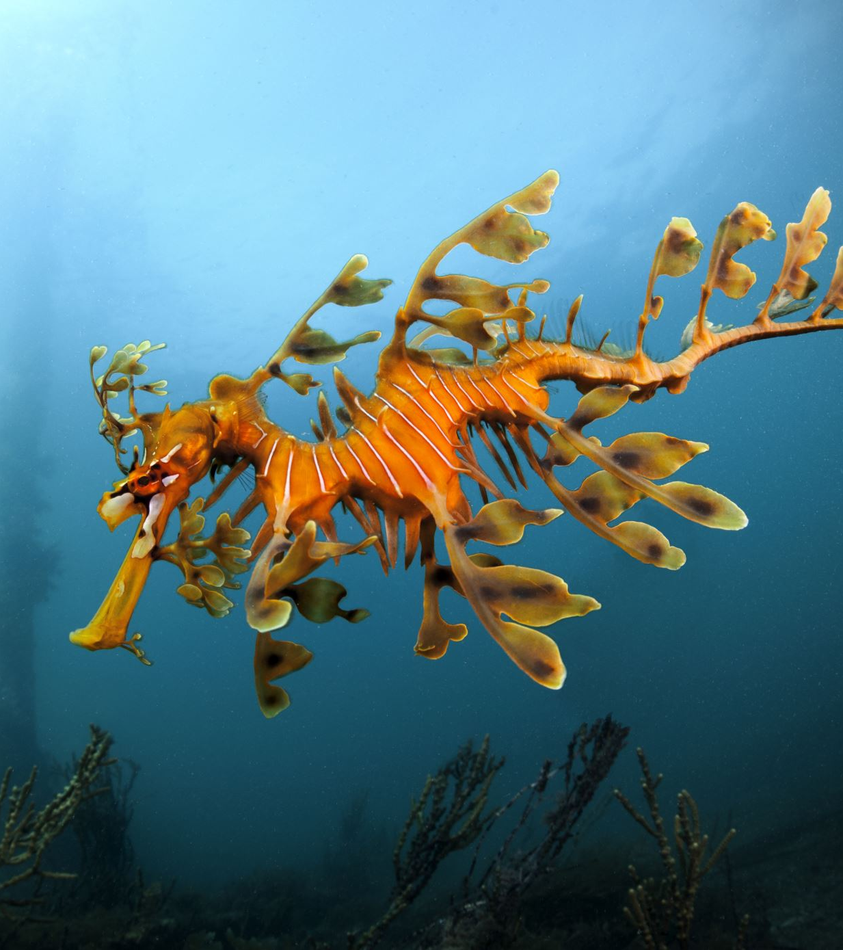
Mid-game twist
Just this week, the endangered Golden Hoofed Seahorse has been newly discovered along the shores of Bounty Bay and in some of the reef areas.
Its habitat needs to be protected from human activities.
Planner decides where exactly to place these.

Slide 23
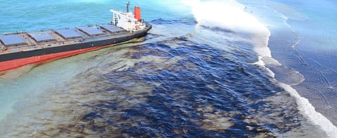
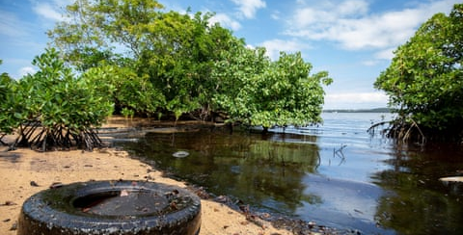
Mid-game twist
There has been a large oil spill from one of the tankers that left Bounty Bay.
The oil carpet is stretching across a shipping lane, toward the shore and endangering some of the sensitive habitats.
Planner decides where exactly to place this spill.

Slide 24

Debrief prompts
How did this exercise go for you/your stakeholder?
What trade-offs were made?
Which interests are most strongly represented in the final map?
What was the process like?
Was the consensus realistic?
After revealing secret goals:
How did hidden agendas shape negotiation outcomes?
Did some players anticipate others’ secrets?
How does this reflect real-world MSP or policy-making?
Any reflections on the process and the outcome?

Slide 25
Marking scheme
Criteria | Description | Points total: 30
Application of MSP Concepts & Context | Demonstrates understanding of key MSP principles (ecosystem approach, social-ecological systems) and process. Can apply these to spatial decisions. | 10
Stakeholder Understanding & Strategic Preparation | Shows solid understanding of own sector’s interests, constraints, and interdependencies with others. Prepares effectively, anticipates others’ needs and develops realistic trade-offs and strategies. | 10
Negotiation, Collaboration & Communication, Reflection | Actively participates in discussion, protects own interests while showing flexibility. Identifies conflicts and synergies. Works constructively with others to balance economic, social, ecological priorities. Proposes feasible, creative solutions. Adapts to new information and changing scenarios. Communicates persuasively and respectfully, presenting arguments and compromises clearly. Reflects thoughtfully about the process, both individually and as a group process. | 10

