Slide 1
EdShare at the University of Southampton: A reflection and look forward
Kelly Terrell University of Southampton
@KellyATerrell K.Terrell@soton.ac.uk
#EdShare #OER18
Notes:
I’m part of the Electronics & Computer Science school at Southampton and I head up EdShare, which is a digital content platform designed for sharing teaching and learning materials.
I’ve presented about EdShare at number of events over the past couple of years particularly to highlight its availability to the HEI community and the features it currently offers. For this presentation I going to focus far more on conversations that have been happening at Southampton as we review EdShare and ask how it can better support educators and learners.

Slide 2
Digital content platform designed for sharing teaching and learning materials
Built on EPrints
Created as part of the University of Southampton EdSpace project (part of Jisc Institutional Exemplars programme)
“EdSpace was founded on the institutional need for a single, shared, safe, persistent, storage location for all manner of educational resources”
Built for sharing across university but acknowledgement of increasing activity around open educational resources (OERs)
2007 – 2009 : EdSpace Project
“This project created an institutional share for educational resources, called EdShare. This share was inspired in functionality and ease of use by web 2.0 sites such as YouTube and Slideshare.”
Notes:
EdShare originated from a research project ‘EdSpace’ for which the aim was to deliver institution wide infrastructure which would allow staff (and students) to share all manner of educational materials in a shared, safe, persistent storage location.
Also as part of a drive to encourage and facilitate greater sharing and collaboration across the university.
It was not the purpose of this project to create an OER service, however the growing activity around OE and OER at the time was acknowledged by the project team by the choices that were made. It was hoped that it would support this more as time went on.

Slide 3
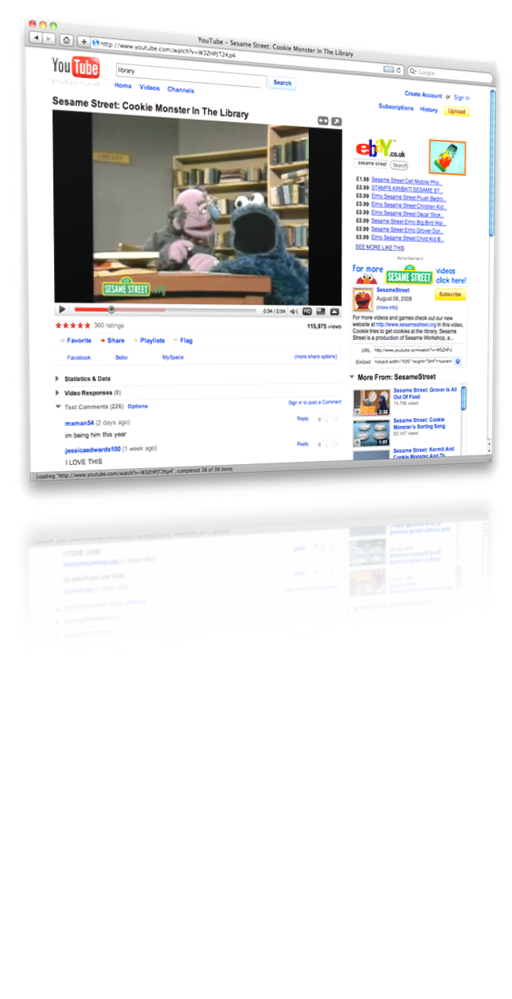
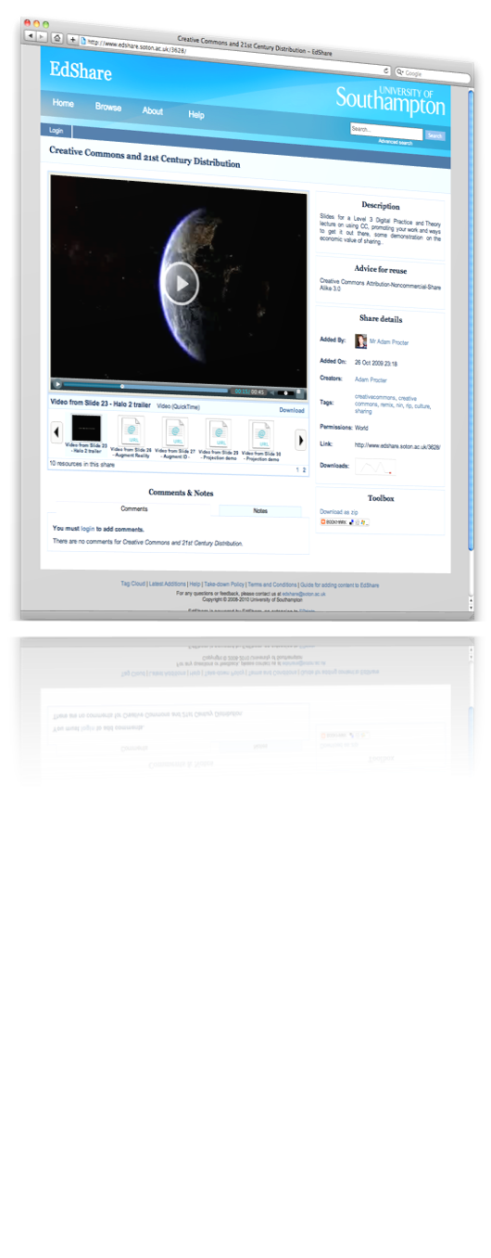
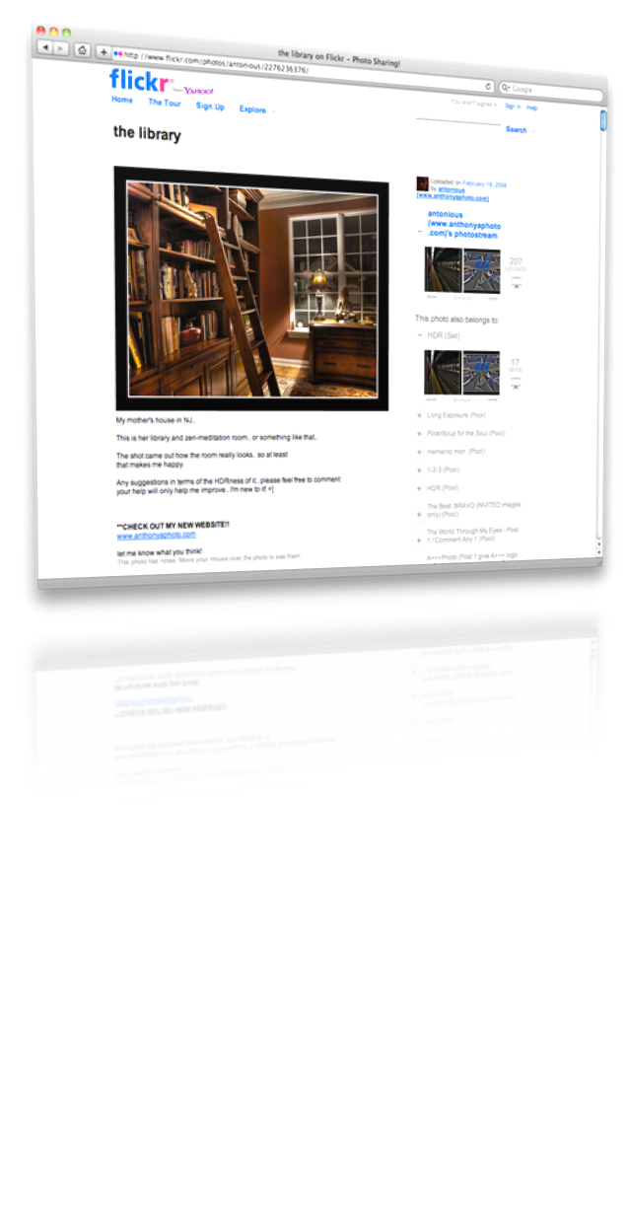
Key influences
Notes:
The design of EdShare was heavily influenced by media sharing sites.
These were examined to identify key factors in their success - things such as hosting, their ease of use, rapid upload to get content live, organisation options and user centric features

Slide 4
Launched in 2008 edshare.soton.ac.uk
Externally
2009 EdShare adopted by EPrints Services
2009-2012 A number of instances as part of Jisc UKOER programme
2011 onwards – larger scale institutional instances on board
Major service upgrades by EPrints Services – continuing growth of the community of EdShares
Establishment of new services
Within the Institution
2009 – 2011 Follow-on projects
2011 Supported institutional service
2011 iTunes U Southampton launched
2012/13 Feed from EdShare to ECS module pages for students
2014 MedShare launched
Notes:
From EdSpace project EdShare Soton was launched in 2008, and this had a number of ripple effects both internally and externally
Externally
Internally

Slide 5
Launched in 2008 edshare.soton.ac.uk
Stats as of April 2018
460 distinct depositors
4708 resources shared to date
ECS largest number of resources
~450 new resources each year
1.4 million downloads to date
>50% of resources shared with the world
997K hits to date
ECS = Electronics & Computer Science school
Notes:
Last year as we were approaching 10 years since the launch of EdShare and in reflection of this growth and the development effort that had gone in, we held a meeting to discuss EdShare to date, and what needs to come next.
Before I come on to that I thought I would just share some stats on the use of EdShare Soton to put some of this in context.

Slide 6
Reviewing EdShare - Lessons learned, what comes next?
Involving : EPrints Services Enterprise Team (EdShare Lead (me!), EPrints Lead, Developers x 4)
Professor Les Carr, Professor of Web Science, ECS
Professor Hugh Davis, Professor or Learning Technologies, ECS
Dr Lisa Harris, Director of Web Science Institute & Programme Lead Digital Marketing, Business School
Notes:
As part of this meeting with invited key individuals from across the university – this was not a formal or large scale review, rather it was a lengthy but focused conversation.
A key person that came along was Prof Hugh Davis – original lead for the EdSpace project who share his observations and reflections on the EdSpace project and use of EdShare Soton.
The next couple of slides are adapted from what he showed us on the day

Slide 7
EdShare Card
The evidence that people want to share with colleagues anywhere is thin. Mostly share with students
Original slide: Hugh Davis (2017) What would EdShare look like today presentation
Notes:
This is a promotional card used when EdSahre Soton was launched. You’ll see the emphasis is on staff sharing with colleagues, working day to create new resources.
One of the biggest observations was that although the system has been successful as a tool for sharing in the institution, there is little evidence to support that people are sharing with colleagues in mind.
They are mostly sharing with students.
This may not be shocking or surprising, but it does have some really important implications for EdShare because design choices were made for a different audience.

Slide 8
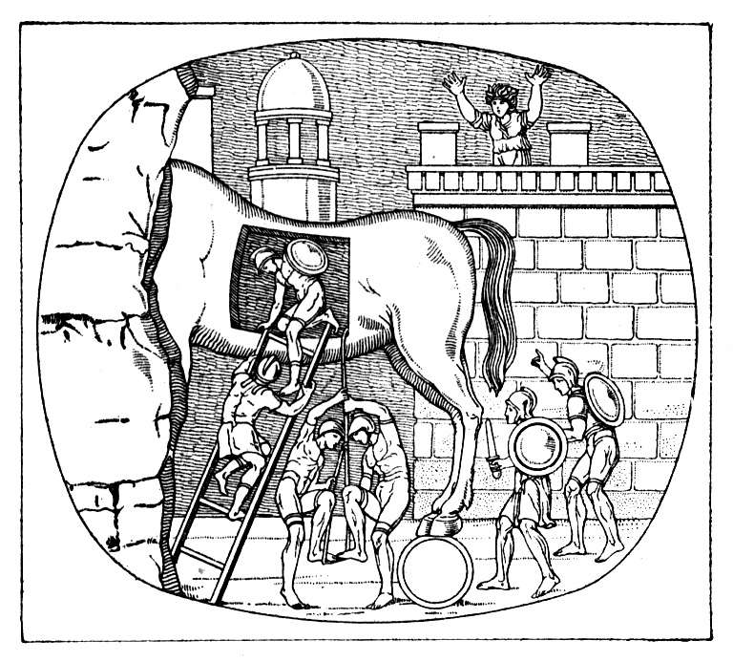
EdShare is a Trojan Horse
Levering our resources out of Blackboard
Exposing our content to the world
A focus for change at UoS
We never got the interface to Blackboard sorted
Original slide: Hugh Davis (2017) What would EdShare look like today presentation
Notes:
The intention was the create a BB building block so for those who eat sleep and breathe blackboard, they could submit with EdShare without needing to think about this other space to start with.
This encountered a number of difficulties in terms of compatibility with BB and the effort level for creating and maintaining was so high it was never fully realised.
This hasn’t been a deal breaker, but is perhaps one of the reasons why we see some parts of the university more than others using EdShare.
What wasn’t considered really was the follow-on effects of taking content out of the VLE
EdShare has ways or organising content but it is not a VLE which knows about the person and what they are teaching or studying.

Slide 9
Key Outcomes
Learners are currently the primary audience, not staff
Not a failing of EdSpace project, rather a reflection of its hopes vs actual use
From Champion Users
Frustration at institutional VLEs and their fixed nature
High appeal of EdShare due to its flexibility and adaptability
Desire to run courses which are not necessarily formally recognised
Greater to support to day-to-day teaching & learning activities
Course/Module lists, Lesson plans as well as the individual resources
Connect all users in EdShare – social interactions
Exploration of learner metrics
Notes:
Learner are the primary audience, not staff – people are using it, variations in how it’s being used, sharing and collaboration between colleague inside/outside may be limited, but it’s still remains a guiding principle and aim for EdShare to enable that to happen
Champion Users – those who are active supporters, embraced EdShare and 10 years on are looking for more. Lots are in ECS. See a problem, have already worked out how they want it to behave and how it would look.
They want to push boundaries, run open courses, activities that are not formally recognised by the institutions
That is why EdShare is so appealing, used so heavily in ECS – that adaptability is built in and at our finger tips.
Greater day-to-day support
Variation in how people are working – 1 person wants lesson plans, another wants module lists, one only attachs 1 file per resource – not interested in resource page, another treats a resource as containing many files of value.
Connect with learners, and for learners to connect with one another, to discuss resources (flipped classroom)
Metrics –
Usage/interaction metrics to help target improvements
Not trying to be a VLE, but sometimes it’s a fine line

Slide 10
Challenges to moving forwards
We (ECS/EPrints Services) do not own the EdShare Soton instance
Challenging climate – financial pressures, system reviews, staff & ownership changes
Promotional, visible user support effort no longer exists
Funding for service maintenance but not developments
Risk averse – though it depends who you talk to!
Range of awareness levels across the university
Misinformation easily spreads without champion users and clear owners
Notes:
We have the team, the expertise and are leading the ongoing development of the generic EdShare offering

Slide 11
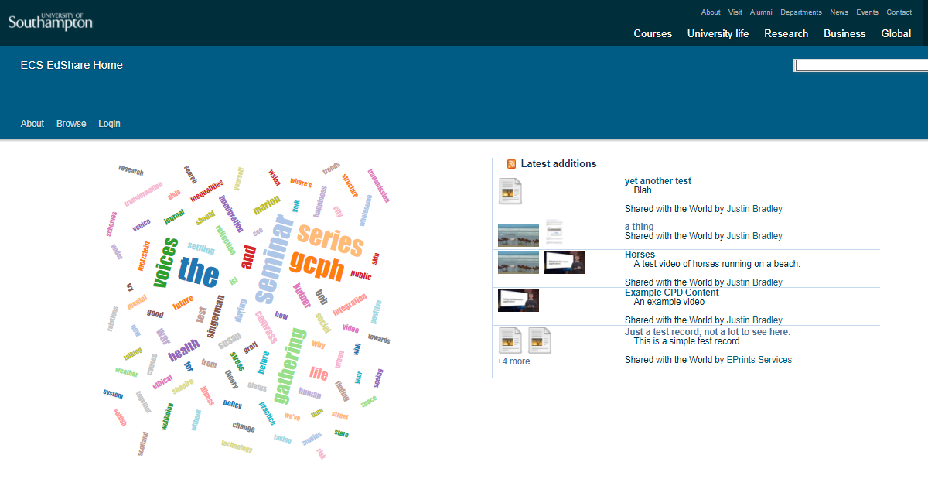
ECS EdShare – a space to innovate
Platform for hosting collections of videos used as part of ECS modules
EdShare chosen due to its flexibility and adaptability
Ability to use this project as a vehicle for innovation and to deliver new features for champion users
Opportunity to deliver real change for both teachers and our learners
Currently under development
Notes:
For me those challenges are very frustrating, and it feels a little like your playing a game something. You have to choose your battles. You need to be part of the right conversations, and then you will see opportunities arise that perhaps were not part of your plan originally but help you take those next few steps in the journey.
That is what has happened for us with EdShare. Some funding was made available to create a video production suite and part of this was a need for large expandable storage and to provide access to videos to people across the school or beyond. As for this EdShare has been chosen. As well as that immediate project requirement, this has now also provided us with the space where we can roll-out those improvements we have been talking about. We can demonstrate their value, and then when others are ready including our own Soton instance they will I hope take advantage of this.

Slide 12
Rich text description with complete flexibility to format and style as you wish, embed media
Private to you only, or share it publicly for others to view
Resources to display – either internal to the EdShare instance or external links
Lists, which can enable >>

Slide 13
Presentation of modules
The same feature could be used for open courses
Notes:
One such use case can be for the presentation of modules.
This content was taken from a bespoke system we have running on our intranet. Very quickly and easily I have reproduced the same screen with same access point, but all of a sudden it is now open.
Isolated resources are immediately given greater context of use, and the ability to see them in a sequence.
Individual resources suddenly become much more useful to someone viewing them who is not a subsc

Slide 14
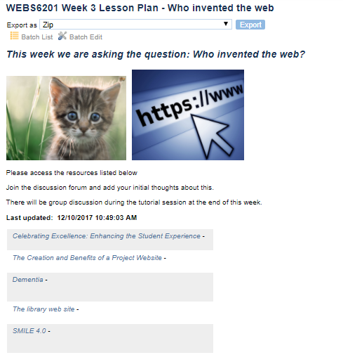
Lesson plans or Playlists
Notes:
Using the identical features, we can produce
Lesson plans, exact same thinking as the module - suddenly this content has been broken out of a closed bespoke system or simply a PDF
Playlist – user generated, either for their own purposes or for sharing.
People can subscribe or follow a module, lesson plans to receive updates.
We have the potential here to then start thinking about wiki-like behaviour and groups coming together to build a collection of resources and then that in itself becoming an open educational resource

Slide 15
edshare.ac.uk
@EdShare
EdShareHUB
A community service providing a federated search across the collective EdShare platforms of all content shared with the world
Visit edshare.ac.uk
MedShare
~8000 resources shared with the world to date
Any Questions?

