Slide 1
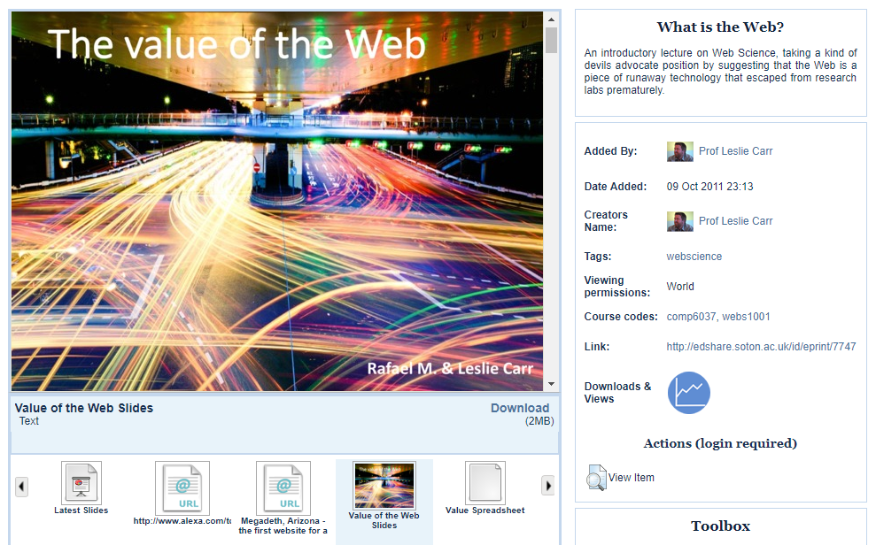
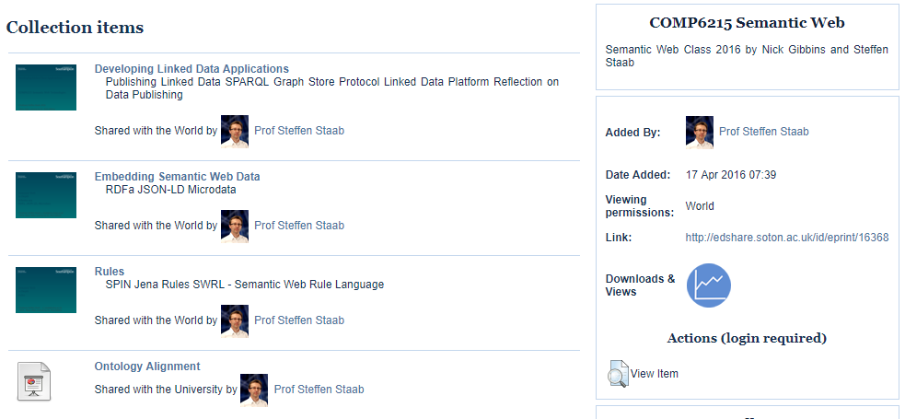
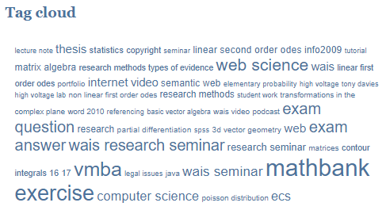
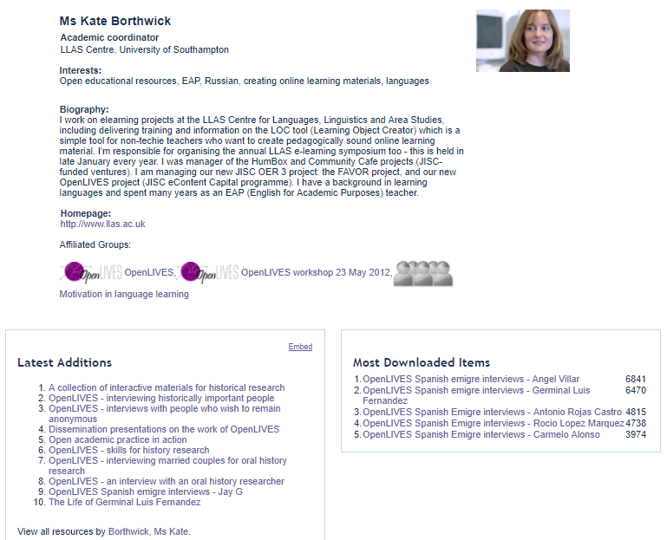
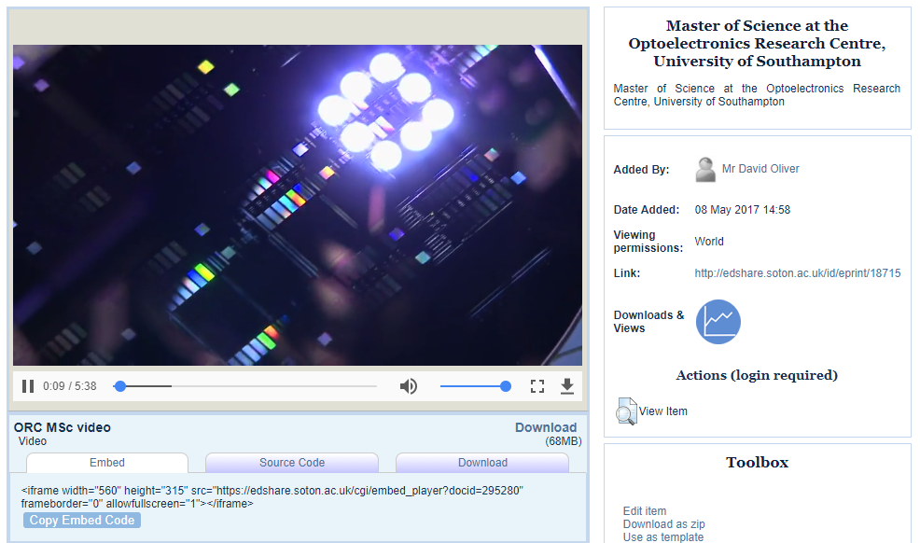
Kelly Terrell, Sheridan Brown
The open educational resources platform from the experts behind the world-leading open access software EPrints
Persistent, secure storage for your materials
Liberate teaching materials from closed systems
Inline previews of materials
Light-weight immediate deposit
Organise resources into collections
Help visitors navigate your materials through the use of tags, bringing together distributed related content in one place quickly and easily
Share Documents,
Video, Podcasts,
Presentations, Images, Interactive Packages, Collections, anything
Scrollable previews are available for the majority of uploaded content, removing the need for visitors to download to determine if it’s the resource they need
Embed materials in other spaces
Flexible viewing permissions
Flexible and adaptable
User community profiles
Flexible viewing permissions to support both open and restricted resources. Metadata will always be open.
Editing permissions can also be granted
Logged in users can decide to have a public profile page to showcase their work and connect with others
HTML5 support for Video and Audio
Multiple derivatives of the original video/audio upload are produced to support playback across devices
Easy to use interface – influenced by web 2.0 sites
Apply the latest creative commons licence
Always absorbing generic OA driven and standards updates from EPrints
Widgets are available on a users homepage and profile page to display user specific sets of information
Embeddable HTML5 player support so when this resource is embedded elsewhere, such as a VLE, the end user can control playback
Our development roadmap on
Creation and display of lesson plans and modules, including calendar mode
Creation and presentation of open courses
User generated playlists
Discussion forum support at the object level
Panels plugin to support display of feedback, ratings, sharing and favourites tools all in one place
EdShareHUB – add on service harvesting content with a creative commons licence from all EdShare instances
Join our growing community
EdShare at Glasgow
Full hosting and support available from EPrints Services. Be part of the future development of EdShare.
EdShare
edShare@GCU
Visit www.eprints.org/edshare for further information

